Slide 1
Mobile Health Care Application
Subject: ENSE 885as, "Topics in Computer-Supported Collaborative Work
Instructor Name: Timothy Macing
Presented by: Reema Jiyani

Slide 2
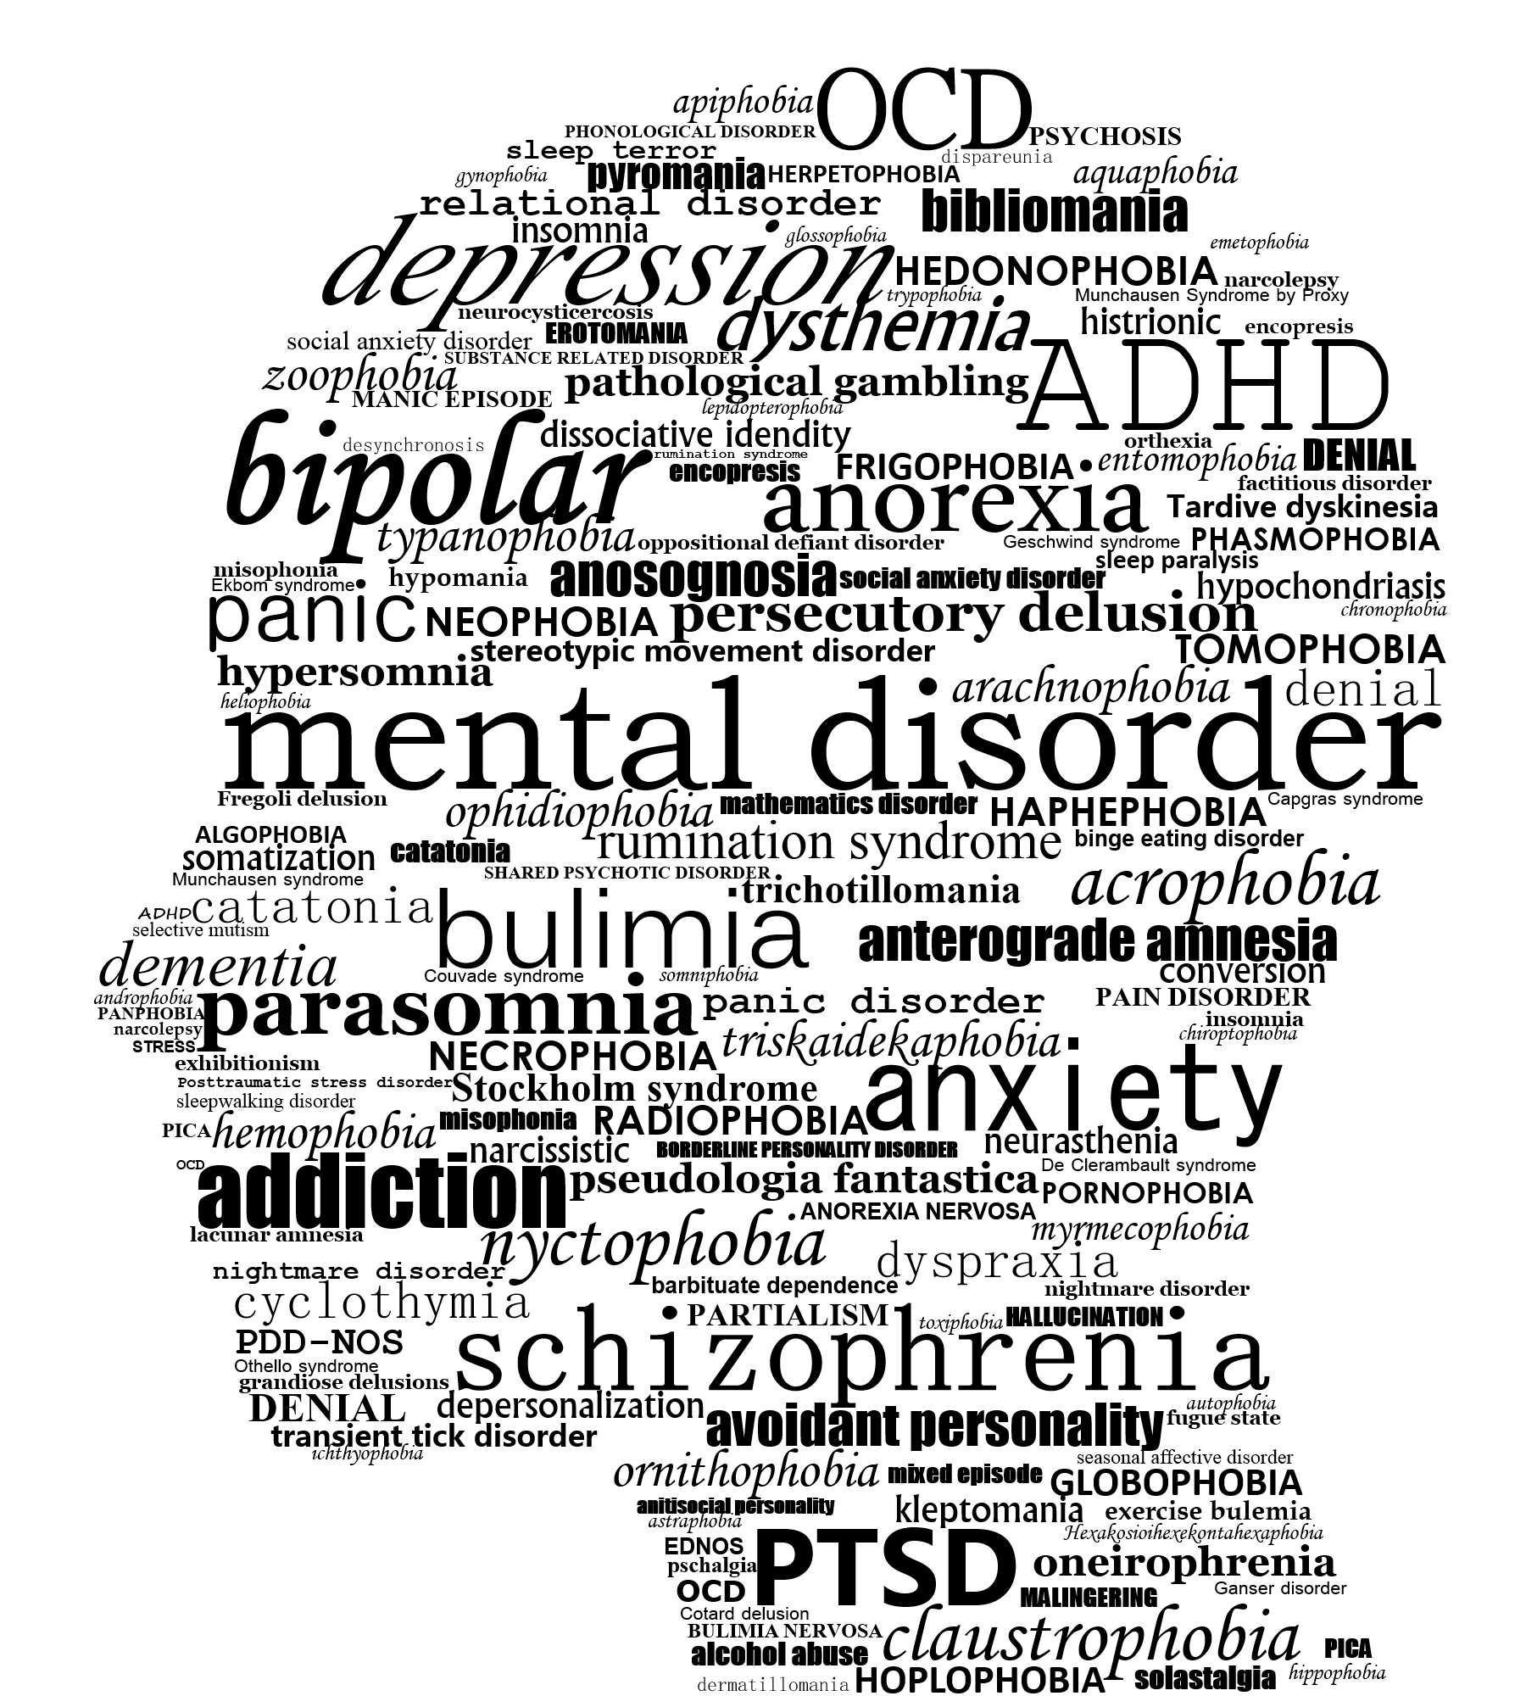
UN goals for my project
In my Mental Health Care application, I decide to focus on below
two goal for Sustainable development:
Goal 3: Ensure healthy lives and promote well-being for all at all ages
Goal 17: Revitalize the global partnership for sustainable development

Slide 3
MVP1 Deliverables
Exploring Flutter technology and dart language
Splash Screen for my application (an introduction page on a application)
Onboarding Screen (3 swipe screen, essentially a series of screens which direct users through an app interface)
Authentication (Sign-in/Sign Up/ forgot password)
Homepage UI (set homepage features according to user-friendly design)
Scrum Date: 26 May to 1 June (7 days)
Status description: Green
Summary: Proper resource and guidance able to finish mvp1 on time.

Slide 4



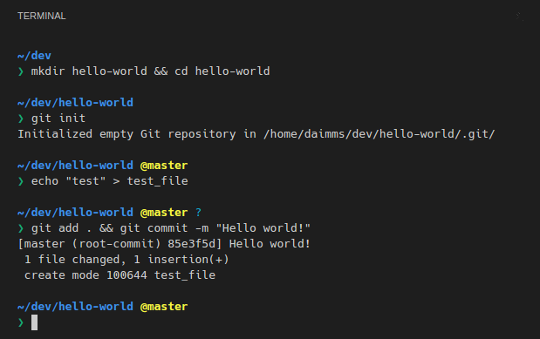

MVP1 Project Tools & Framework
Tools:
Visual Studio
Emulator
Firebase console
Terminal
Framework:
Flutter

Slide 5
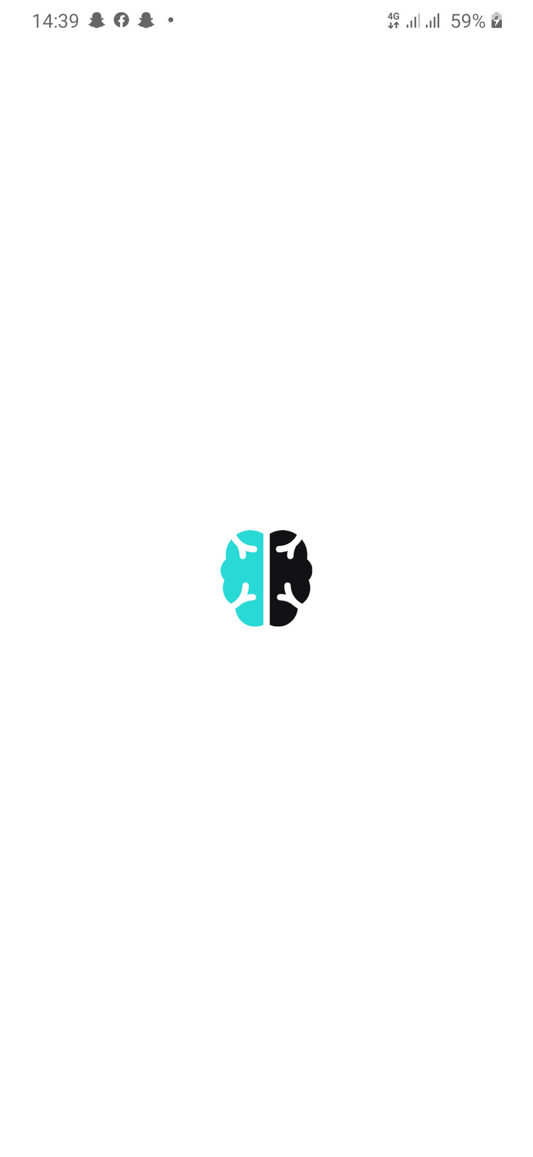
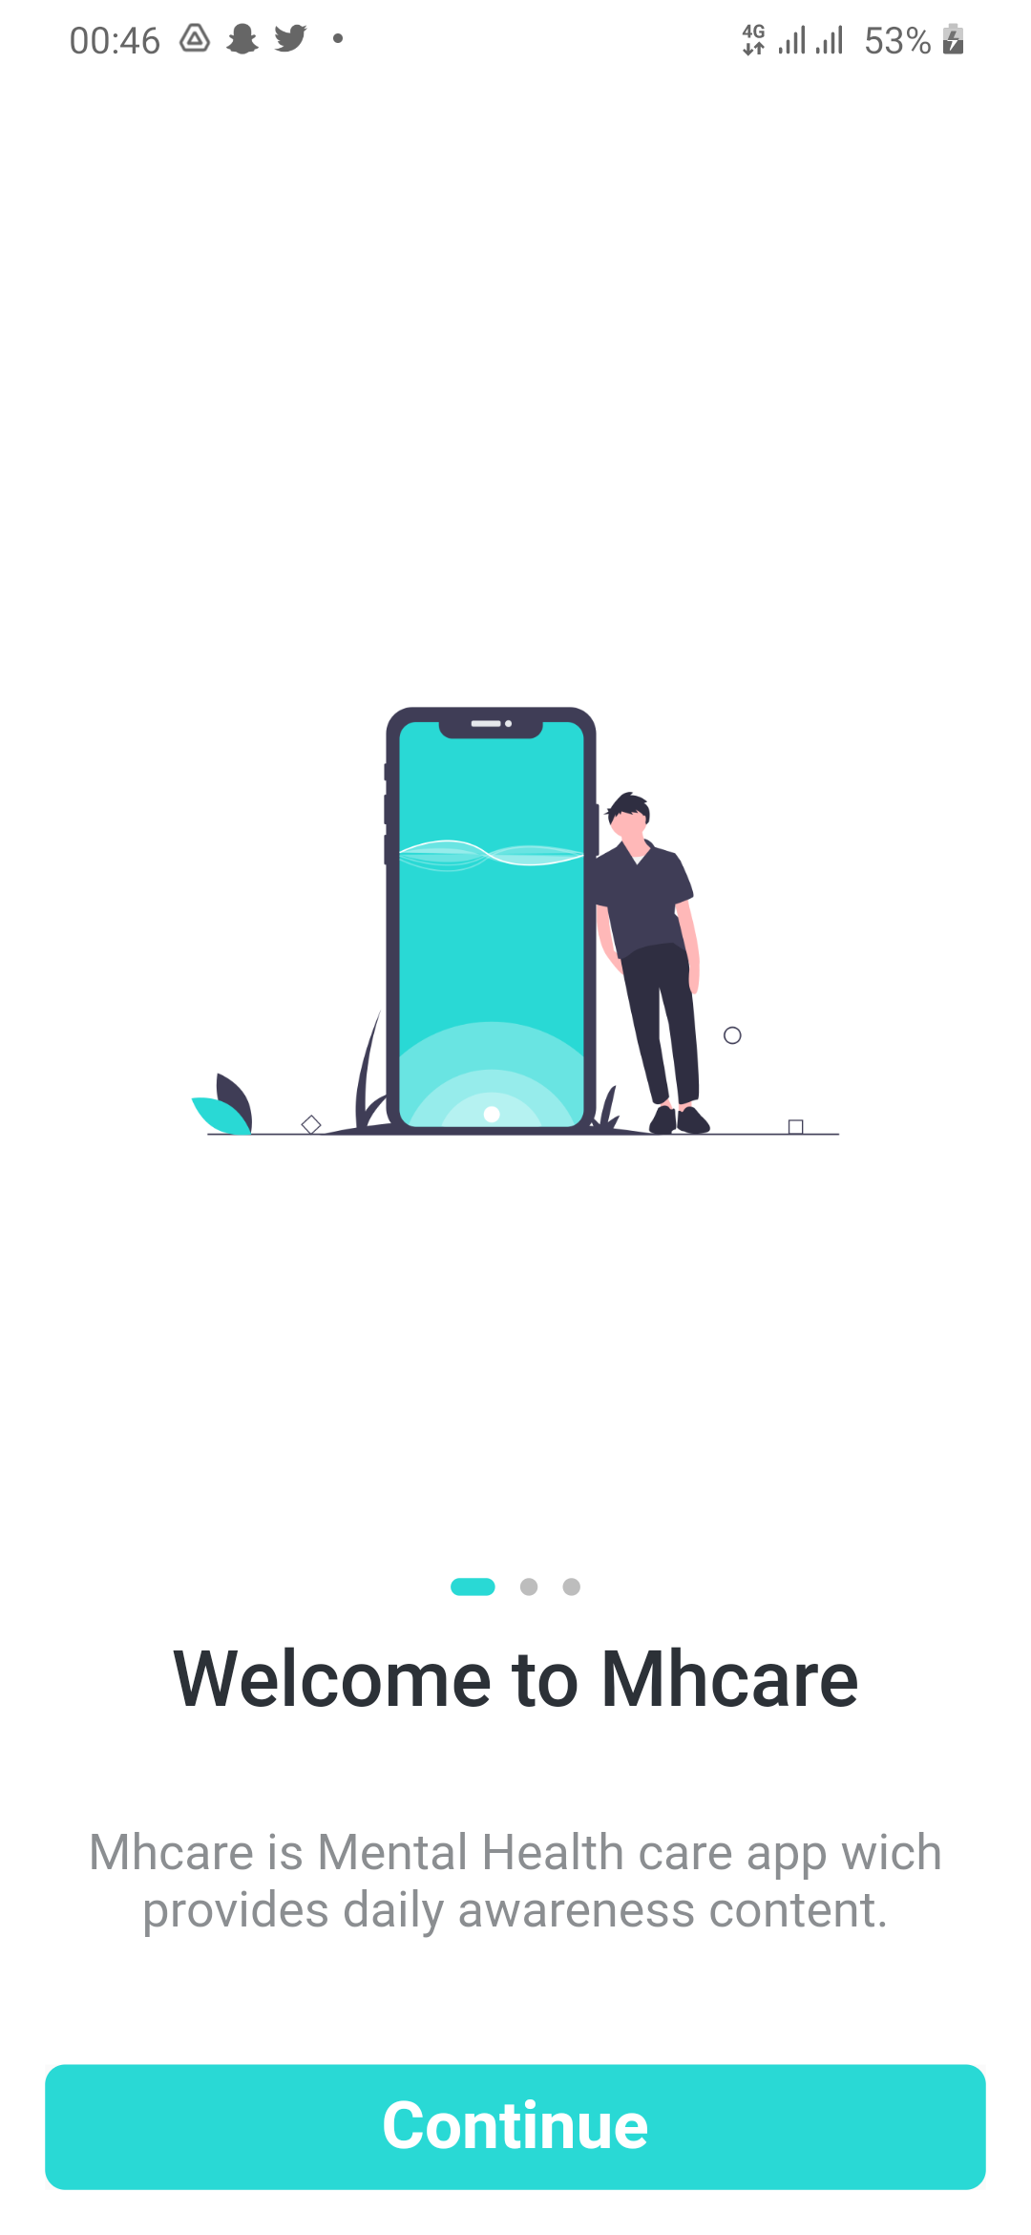
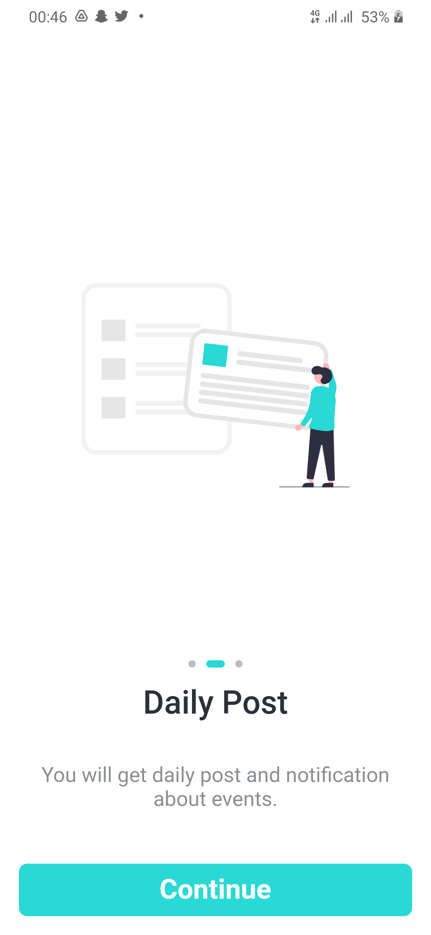
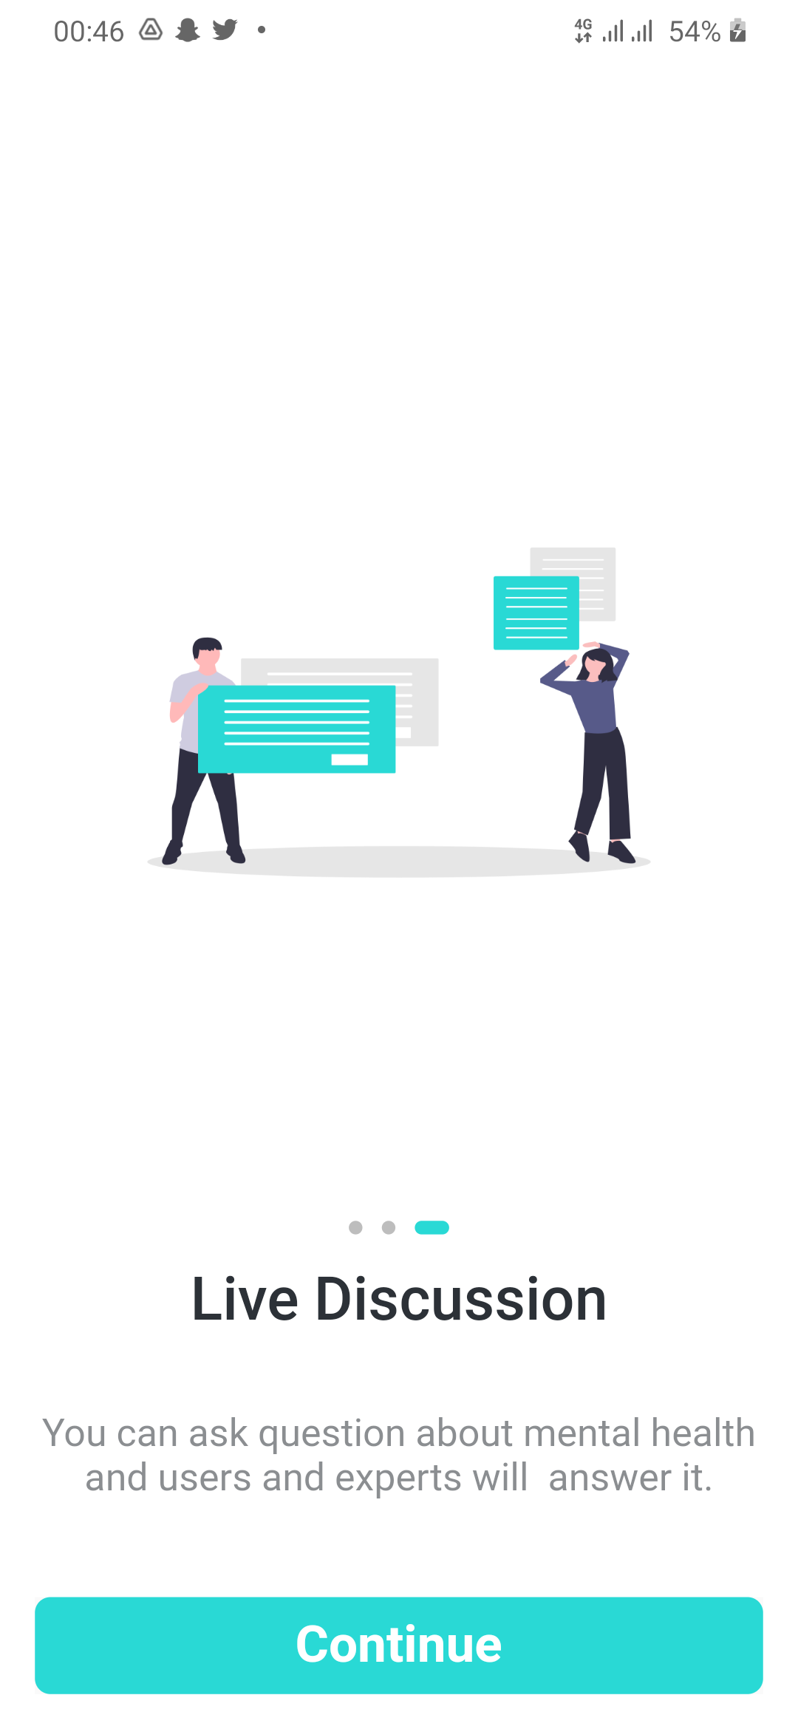
MVP1 Project Demo
Splash Screen and Onboarding screen (Put screenshot here because it loads only when user install first time application so I put screenshot here to show how its look like and everything is working fine able to see in demo video)
Now move to
Emulator &
Visual studio
Splash Screen
Onboarding Screen (3 Swipe Screen)

Slide 6
Next Up & Reflection
MVP2 works on broadcast room and events features.
MVP3 works on forum feature and admin of application.
During MVP1 I specifically like firebase console. It is really easy to setup database and send notification and store data in firebase. As well as, good thing is that firebase is free for students.
And, moving forward I think I need more help with coding because setting I already know how to set code to get outcome. So for that I try to find help from external sources.

Slide 7
Thank you & Any Questions

